Slide 1

Leveraging your HealthCare Broker
KCSHRM Symposium
October 10 2018
Monique Eubanks, MBA
Employee Benefits Manager

Slide 3
LEARNING HR NEEDS
Most small and medium sized businesses need HR support.
    HR professionals expect more from their broker than insurance quotes and open enrollment materials. Your broker should speak with you about your top HR challenges.
With state and federal regulations becoming increasingly complex, providing basic compliance assistance is an easy way to help HR professionals.
    Many HR departments handle compliance tasks, despite it not being their specialty. This makes them rely on their brokers even more for guidance.
According to the Broker Services Survey, 99 percent of employers want their broker to answer compliance-related questions and provide legislative updates.

Slide 4
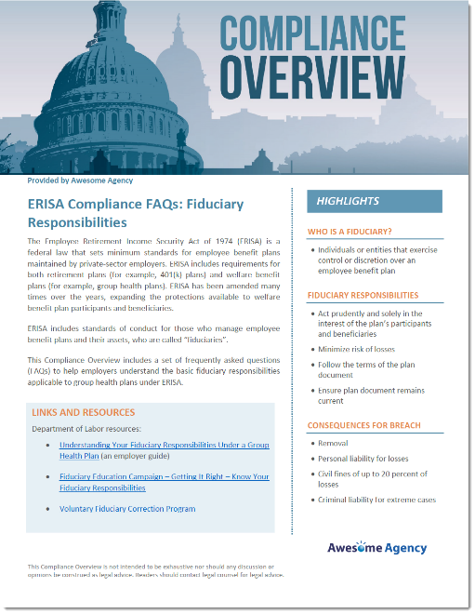
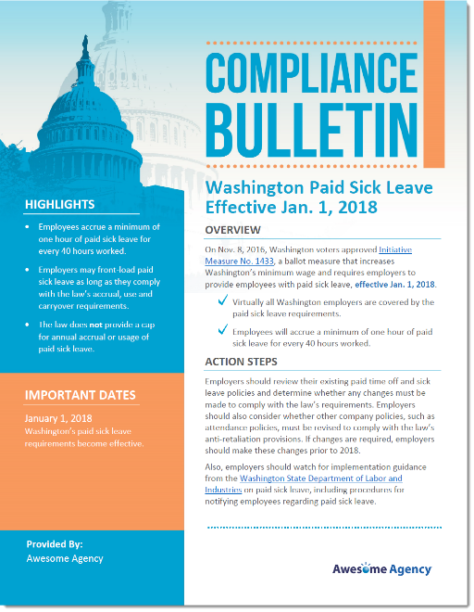
BECOMING A TRUSTED ADVISOR
Helping clients with their HR challenges will position the broker as a trusted advisor and indispensable resource.
    Your broker should have access to and provide resources to tackle major HR concerns, like compliance.
The Compliance Bulletin and Compliance Overview series offered by Zywave cover a wide range of issues, including paid sick leave, discrimination and health care reform rules.

Slide 5
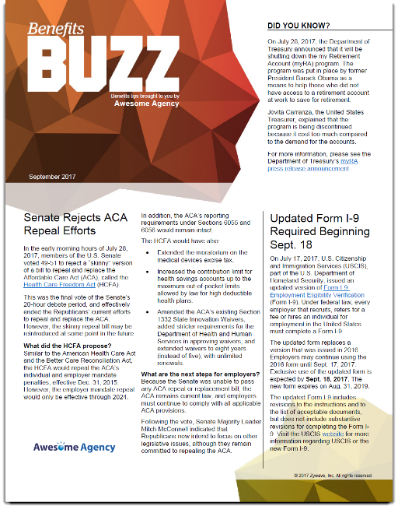
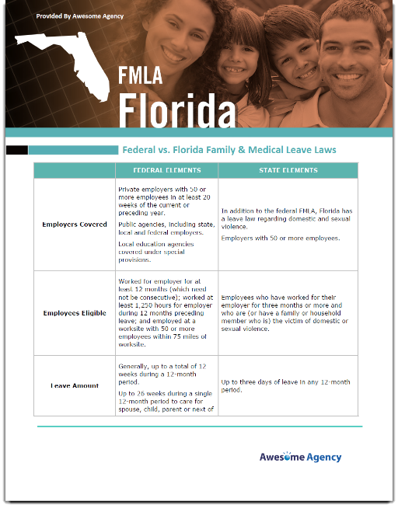
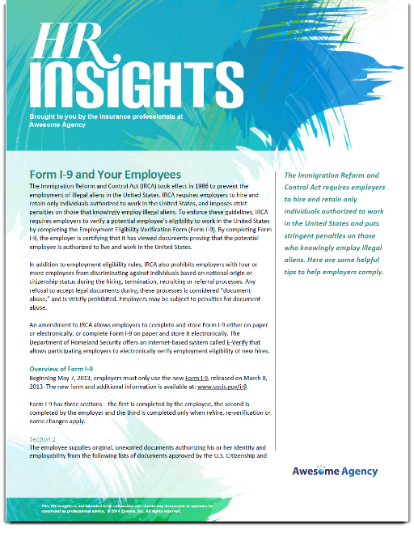

MORE THAN JUST COMPLIANCE
HR challenges go well beyond benefits compliance, and clients need your help solving them.
Broker Briefcase offers solutions to the most complex HR concerns, including the following:
    Understanding employee leave laws
    Developing an employee handbook
    Staying informed on regulatory updates
    Providing employee communication

Slide 6
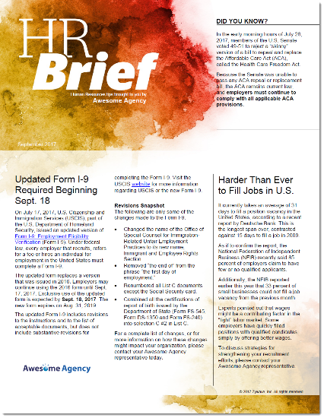
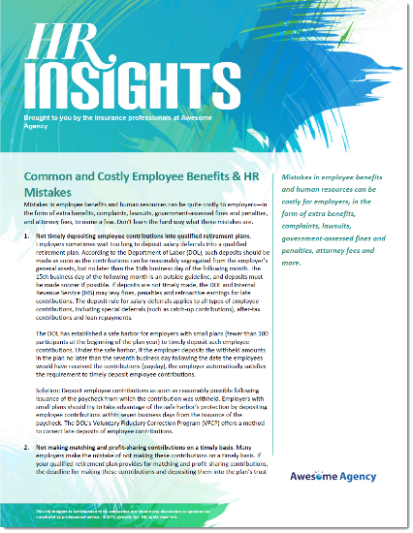
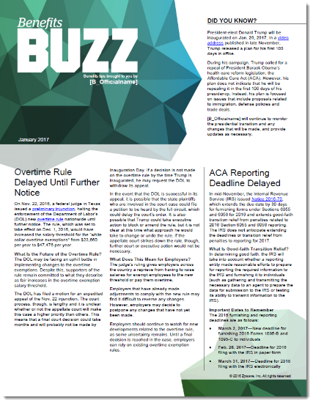
KEEPING UP
Even the most skilled HR professionals have trouble staying up to date on regulatory and legislative developments.
Use timely series like HR Brief, HR Insights and Benefits Buzz to keep clients current on the latest HR news.
    Consider sending these series to clients on a monthly basis so they never have to worry about missing important updates.

Slide 7

Typical Services
From Brokers
  Quote Plans
  Claims & Billing Assistance
  Negotiate Renewal
  Plan Comparison
  Coverage & Policy Expertise
  Application Submission

Slide 8
Typical Services
From Technology Companies
  Vacation Tracking
  Online Enrollment
  Onboarding/Offboarding Assistance
  ACA Compliance

Slide 9
2018 Broker Services Survey
  Conducted in mid 2018
  More than 400 respondents
  Key Findings:
  Creates a multiyear strategic benefit plan that aligns with company goals.
  Offers employee communications to help employees improve their health and become wise consumers of health care.
  Provides online access to policies and compliance HR tools.
  Provides plan design benchmark information.

Slide 10
2018 Broker Services Survey
Communication
76% of insurance buyers want a broker who communicates at least monthly
40% of insurance buyers would consider changing their broker due to lack of communication
99% of employers say it is important that their broker can answer compliance related (FMLA, ACA, COBRA, HIPPA) questions
93% of employer state that their broker should offer employee communications to improve their health and become wise consumers of healthcare.

Slide 11
The Client-Broker Relationship
Top Ask:
Trusted advisor with prompt and effective service and timely answers to questions.
Dissatisfaction:
Timeliness and ineffective service
Not trusting in the broker’s ability

Slide 12
The Client-Broker Relationship
Criteria:
Must provide prompt and effective service
Regular communication
Is a trusted advisor
Has ability to negotiate the renewal
Offers resources
Has a good reputation* letters of recommendation

Slide 13
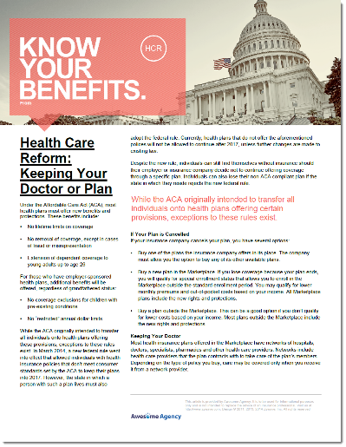

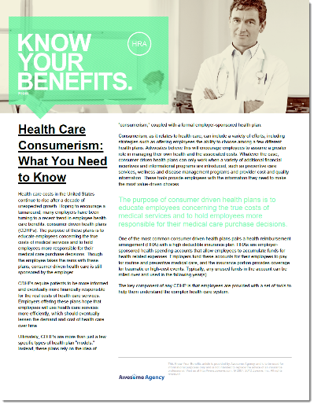



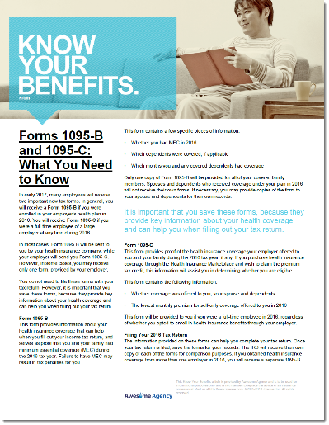


BROKER BRIEFCASE RESOURCES
Know Where to Go - Choosing the Right Health Care Provider - Video
Health Care Reform: Keeping Your Plan
Your Health Plan: Understanding Your Explanation of Benefits
Health Care Consumerism - What You Need to Know
7 Tips for Health Care Spending - Video
Benefits 101: Introduction to Group Health Insurance Video
Health Insurance Terms You Need to Know
Forms 1095-B and 1095-C: What You Need to Know
Know Your Options

Slide 14

BENEFITS BENCHMARKING
Broker Briefcase features the annual Employee Benefits Benchmark survey, with data from employers across the country.
  Use this to see how your clients stack up in terms of employee benefits.
Provide clients with the Health Plan Design Benchmark Report to assess the competitiveness of their health plans.
This benchmarking information is critical for ensuring your clients remain competitive when trying to attract and retain talent.

Slide 15
The Client-Broker Relationship
Challenges:
Managing health care costs continues to be the top challenge for employers.
Helping employees understand and appreciate their health care options provided.
Attraction and retention as the labor market continues to make hiring skilled workers difficult.

Slide 16
How to find the “right” broker
Employee Benefits Broker RFP Questionnaire – Please refer to hand-out
This questionnaire can help you prepare an RFP for an employee benefits broker. It includes questions that will differentiate one agency from another, including questions about value-added services, data analysis and legislative compliance capabilities.

Slide 17

Exceeding Expectations
With a Full Spectrum of Solutions
Claims Analytics
Compliance
& Legislation
Insurance
Guidance
Online Enrollment
& HR Support
Communications & Marketing

Slide 18


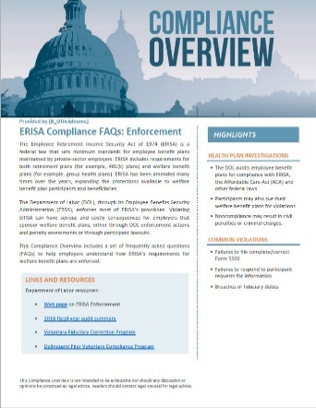
Compliance & Legislation
So You Can Rest Easy
  ACA & DOL Compliance
  6055/6056 Reporting
  1094/1095 Filing
  HR Assistance
  Employee Benefits Statements
  Employee Handbook

Slide 19
Benefits Comply – provide access to regulatory analysts and legal professionals unmatched in their depth of experience and ability to assist employers with a wide variety of employee benefits compliance related issues including:
Health Reform
HIPAA Privacy and Security
COBRA and State Continuation
ERISA
Section 125
HIPAA Title I
HRA and HSA rules and regulations
State Insurance Rules and Regulations

Slide 20
Think HR – combines the best in live human resource expertise with innovative online technology to deliver trusted HR knowledge solutions that enable organizations to thrive.
Learn Pro
Live Certified HR experts
Comply
Insight
http://insurica.thinkhrlive.com

Slide 21
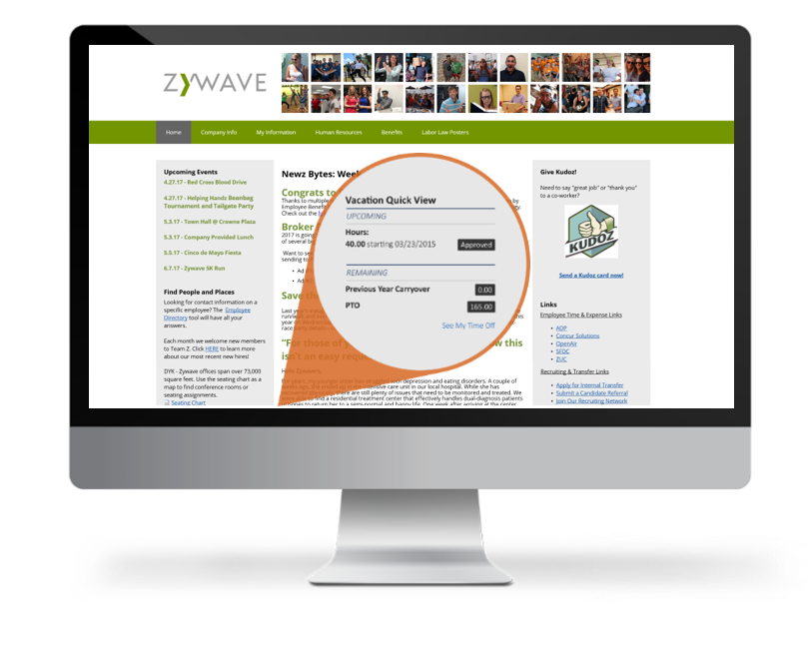
Online Enrollment & HR Support
Simplifying the Day to Day

Slide 22
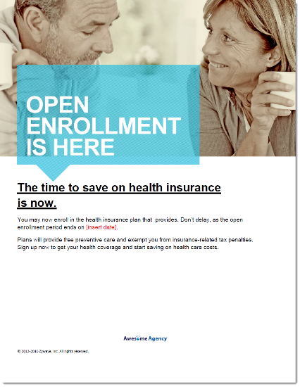
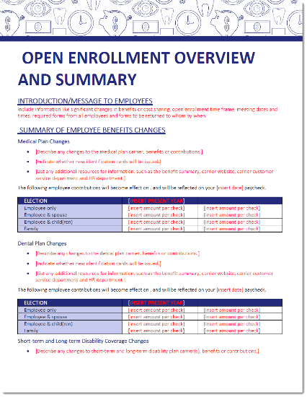


ENROLLMENT COMMUNICATION
Your broker should provide open enrollment resources like posters, payroll stuffers, videos, interactive tools and PowerPoint presentations designed to make open enrollment easy for employees.
  These employee-facing resources are great for tasks like reminding employees about enrollment dates or explaining complex benefit topics.

Slide 23
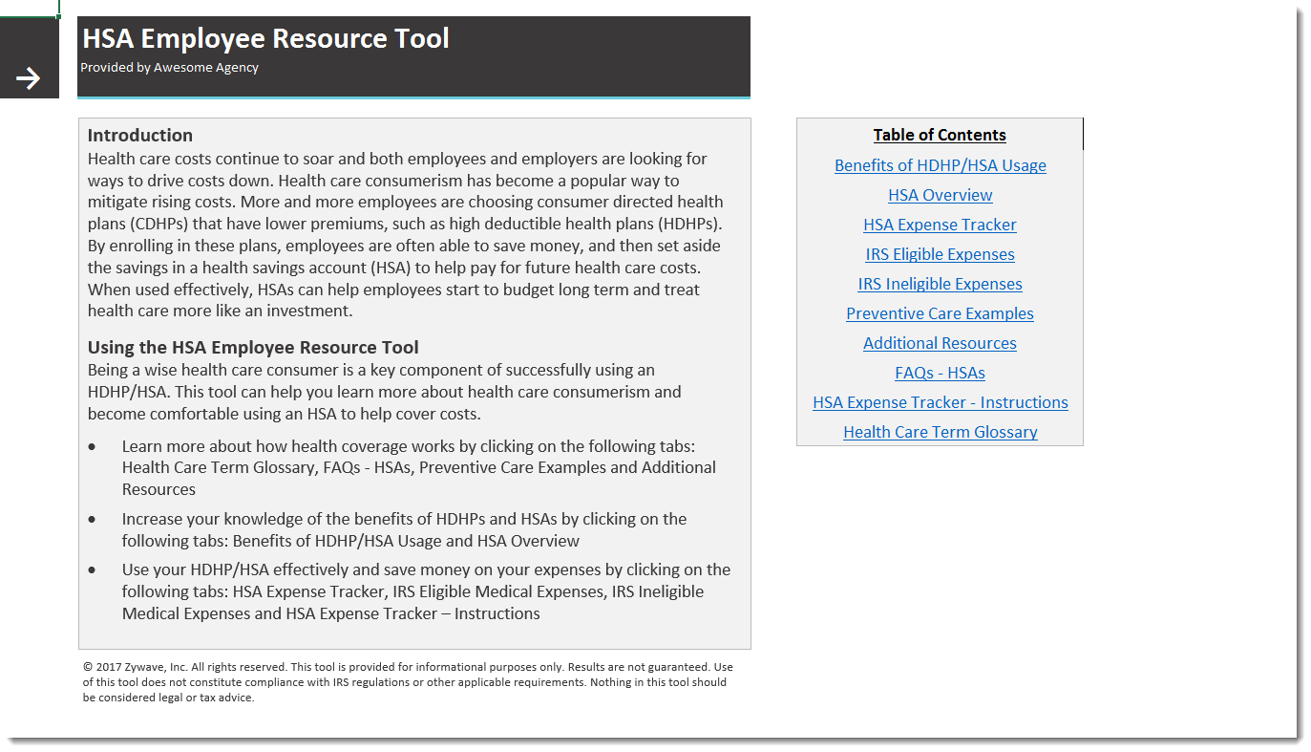
EXPLAINING AN HSA
Health savings accounts (HSAs) are growing in popularity, so it’s critical that employees have the tools to understand this type of benefit.
The HSA Employee Resource Tool is an interactive tool that helps employees learn more about health care consumerism and explains the value of using an HSA to cover health costs.
  Resources like this can help clients and their employees save money in the long term.

Slide 24
Maxwell Health – online enrollment platform that navigates complexities of HR and Benefits
• Handling the mess of paperwork that accompanies open enrollment
• Low levels of employee participation in benefits offered
• Giving employees an easy, streamlined benefits enrollment experience
• Dealing with employee questions about benefits throughout the year
• Improving employee health resulting in lower costs for the employer
• Engaging employees in actually using their benefits
www.maxwellhealth.com/about/video

Slide 25



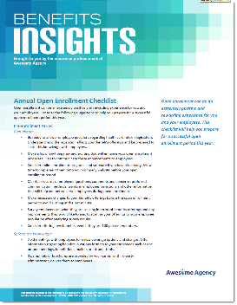
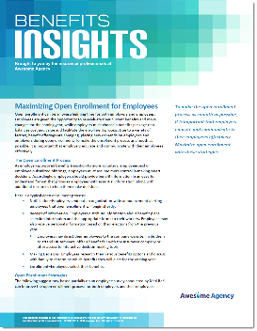
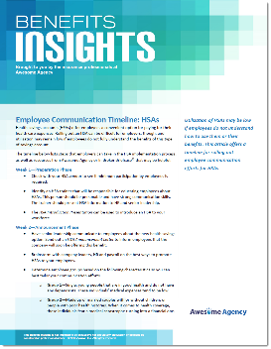

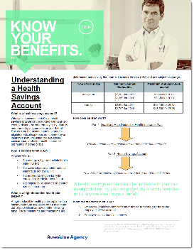
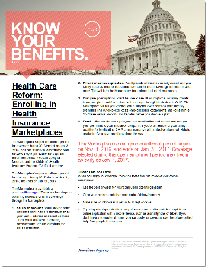

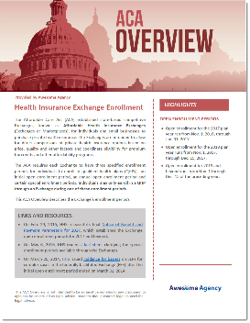

ADDITIONAL RESOURCES
FOR EMPLOYEES
FOR EMPLOYERS
Benefits 101 Guide
Voluntary Benefits - Employee Guide
Health Benefits Poster
Annual Open Enrollment Checklist
Maximizing Open Enrollment for Employees
Employee Communication Timeline: HSAs
Health Plan Enrollment – Rules and Strategies Presentation
Benefits Summary
Understanding a Health Savings Account (HSA)
Health Care Reform: Enrolling in Health Insurance Marketplaces
DOL Audit Guide: Employee Benefit Plans
Health Care Reform: Health Insurance Exchange Enrollment

Slide 26


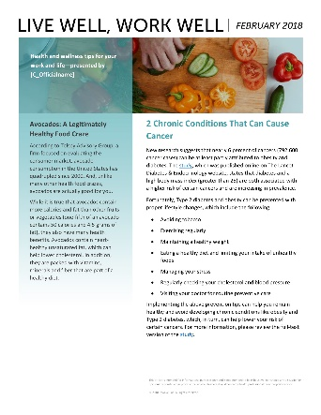
Communications & Marketing
For Employee Engagement
  Health & Wellness Information
  Healthy Lifestyles/Fitness Programs
  Employee Newsletters & Videos
  Employee Communications

Slide 27



Slide 28
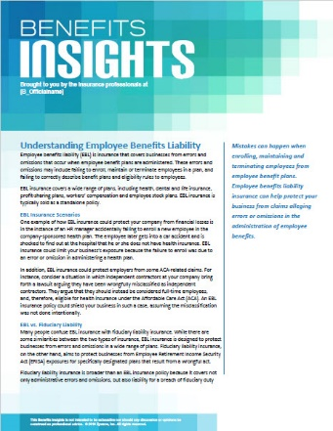

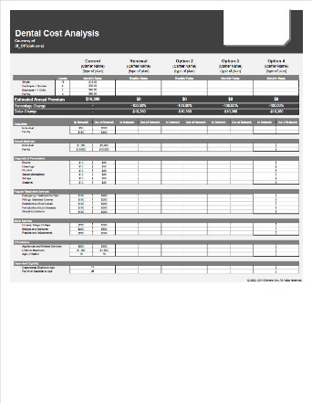
Insurance Guidance
From a Trusted Source
  Quote Plans
  Claims & Billing Assistance
  Negotiate Renewal
  Plan Comparison
  Coverage & Policy Expertise
  Application Submission

Slide 29

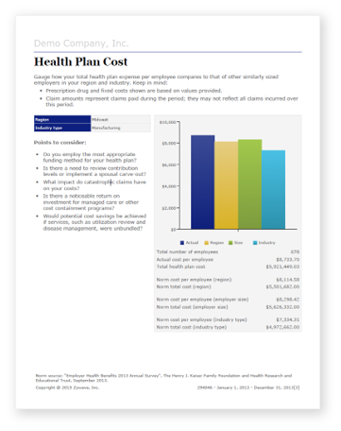

Claims Analytics
Simplifying the Day to Day

